Slide 1

AI Dataset Analyser
Vishwakarma Institute of Technology , Pune
Department of Information Technology
Guide: Prof. Kishor Pathak
Students Names:
1. Parth Birari , 54, IT D, 1251130415
2.Parth Dongre , 54, IT D,1251130421
3. Aryan Patil, 55,IT D, 1251130411
4. Atharv Patil, 56, IT D, 1251130441

Slide 2
Content
Introduction
Motivation
Literature Review
Research Gaps Identified
Objectives
Project Status
Problem Statement
References

Slide 3
Introduction
The Offline AI Data Scientist is an intelligent system that analyzes datasets and generates insights automatically.
It performs data cleaning, statistical analysis, and visualization without requiring manual coding.
An LLM enables natural language explanations and “chat with your data” interaction.
The system works completely offline, ensuring privacy and no dependency on APIs or internet.
It combines automation, explainability, and accessibility into a single data analysis pipeline.

Slide 4
Motivation
Data analysis requires coding or expensive tools.
Existing tools don’t cover the full pipeline.
Online AI tools raise privacy concerns.
Results are often not explainable.
Real-world data is messy, tools assume clean data.
No single system handles everything offline.
Need a simple, private, all-in-one solution.

Slide 5
Literature Review
Title | Citation (Author et al. / Year) | Objectives claimed by authors in their paper | Methodologies used | Outcomes (from result & Discussion) | Gap Identified (Generally from Conclusion & Future scope)
InsightPilot: LLM-Guided Insight Exploration | P. Ma, R. Ding, S. Wang, S. Han, and D. Zhang, 2024 | Traditional tools answer one query at a time. This paper enables multi-step exploratory data analysis using LLM planning. | LLM selects actions like understand, summarize, compare, and explain, forming a chained workflow. | Produces more complete and structured insights instead of isolated answers. | Limited evaluation scale; depends heavily on underlying insight engine.
TiInsight: Natural Language to SQL-Based EDA Pipeline | J.-P. Zhu, B. Niu, P. Cai, Z. Ni, K. Xu, J. Huang, S. Ma, B. Wang, X. Zhou, G. Bao, D. Zhang, L. Tang, and Q. Liu,2024 | Convert natural language queries into SQL-based analysis and visualizations. | Uses schema understanding, query clarification, SQL generation, and chart recommendation modules. | Handles vague queries well and performs strong database exploration. | Limited to structured databases; cannot handle raw or unstructured datasets.
LAMBDA: Agent-Based Code Generation for Data Analysis | M. Sun, R. Han, B. Jiang, H. Qian, D. Sun, Y. Yuan, and J. Huang, 2024 | Improve reliability of automated data analysis through code generation and debugging. | Two-agent system: Programmer generates code, Inspector verifies and debugs it. | More reliable and customizable analysis workflows. | Higher computational cost and slower execution due to multi-agent setup.

Slide 6
Literature Review
Title | Citation (Author et al. / Year) | Objectives claimed by authors in their paper | Methodologies used | Outcomes (from result & Discussion) | Gap Identified (Generally from Conclusion & Future scope)
Talk2Data: Multimodal Conversational Data Analytics | Y. Guo, D. Shi, M. Guo, Y. Wu, N. Cao, and Q. Chen, 2024 | Enable data analysis using natural conversation (text + voice). | Routing system decides between chat response and code execution in a secure environment. | Improves usability and accessibility for non-technical users. | Tested mainly on clean datasets; lacks robustness for real-world messy data.

Slide 7
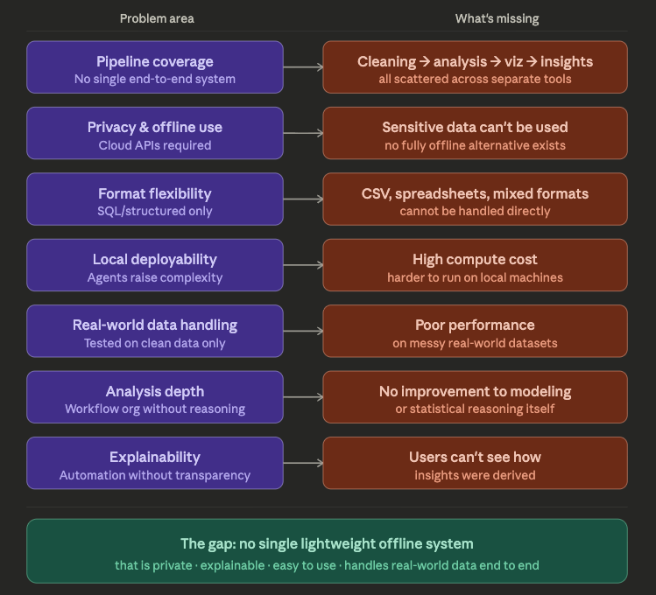
Research Gaps Identified

Slide 8
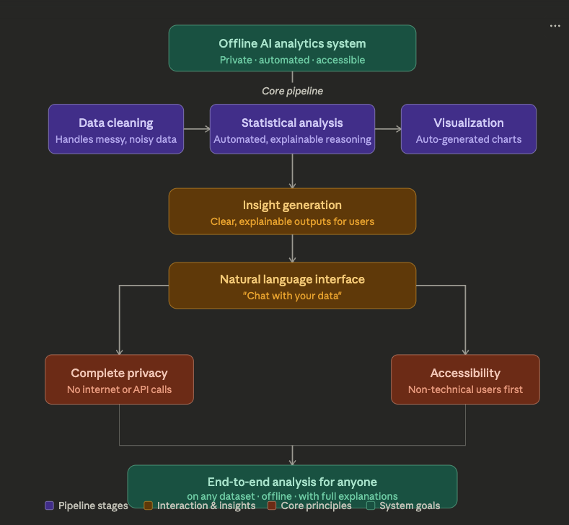
Objectives

Slide 9
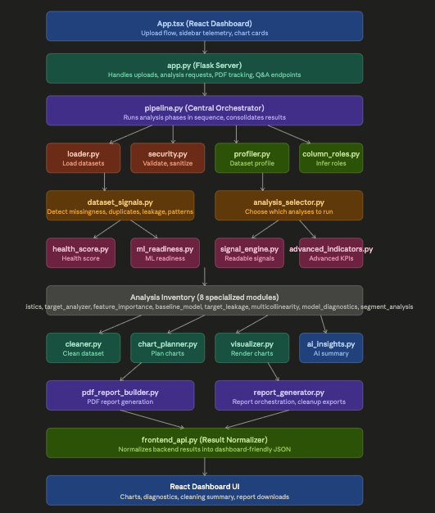
Current Project Status

Slide 10
Problem Statement
There is no single system today that performs complete data analysis — from cleaning to insights — in a simple, automated, and offline manner.
Elaboration:
Most existing tools require coding knowledge or depend on multiple separate steps, making the process complex and time-consuming. Online AI-based solutions rely on APIs, raising privacy concerns for sensitive data. Many systems also assume clean and structured datasets, while real-world data is often messy and inconsistent. Additionally, current tools provide results but lack clear explanations, reducing trust and usability.
As a result, there is a need for a unified system that can automatically analyze datasets, generate insights, explain results, and operate fully offline while handling real-world data effectively.

Slide 11
References
References:
[1] P. Ma, R. Ding, S. Wang, S. Han, and D. Zhang, “Demonstration of InsightPilot: An LLM-Empowered Automated Data Exploration System,” arXiv preprint arXiv:2304.00477, 2023.
[2] J.-P. Zhu, B. Niu, P. Cai, Z. Ni, J. Wan, K. Xu, J. Huang, S. Ma, B. Wang, X. Zhou, G. Bao, D. Zhang, L. Tang, and Q. Liu, “Towards Automated Cross-domain Exploratory Data Analysis through Large Language Models,” Proceedings of the VLDB Endowment, vol. 18, no. 12, pp. 5086–5099, 2025. doi:10.14778/3750601.3750629.
[3] M. Sun, R. Han, B. Jiang, H. Qi, D. Sun, Y. Yuan, and J. Huang, “LAMBDA: A Large Model Based Data Agent,” arXiv preprint arXiv:2407.17535, 2024.
[4] M. N. Al Awad, S. Ivanov, O. Tikhonova, and I. Khodnenko, “A Multimodal Conversational Agent for Tabular Data Analysis,” in IEEE International Conference on Data Mining Workshops (ICDMW), BigIS Workshop, 2025. I could verify the title, authors, and workshop association, but not a final DOI from the sources I checked.

Slide 12
Thank You

